Slide 1
Module II Supervised and Unsupervised Learning Kernel Methods – Instance-Based Methods

Slide 2
Need for Kernel Methods
Problem with Linear Models
Linear classifiers draw straight lines or planes
Fail when data has non-linear patterns
Solution
Map data to a higher-dimensional feature space
Make data linearly separable in that space
However, explicit transformation is computationally ex

Slide 3
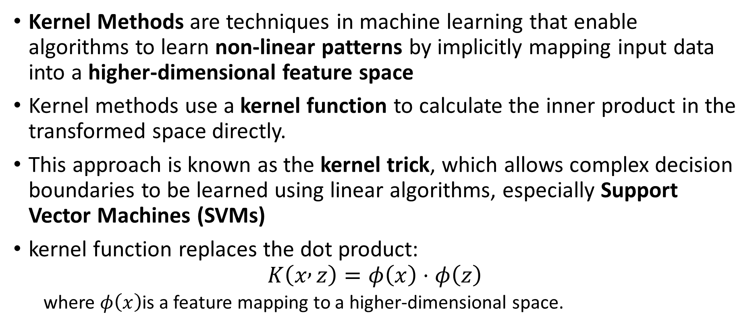
Kernel Methods
Kernel Methods are techniques in machine learning that enable algorithms to learn non-linear patterns by implicitly mapping input data into a higher-dimensional feature space
Kernel methods use a kernel function to calculate the inner product in the transformed space directly.
This approach is known as the kernel trick, which allows complex decision boundaries to be learned using linear algorithms, especially Support Vector Machines (SVMs)
kernel function replaces the dot product:
$$K\left(x , z\right)=φ\left(x\right)⋅φ\left(z\right)$$
where $φ\left(x\right)$is a feature mapping to a higher-dimensional space.

Slide 4
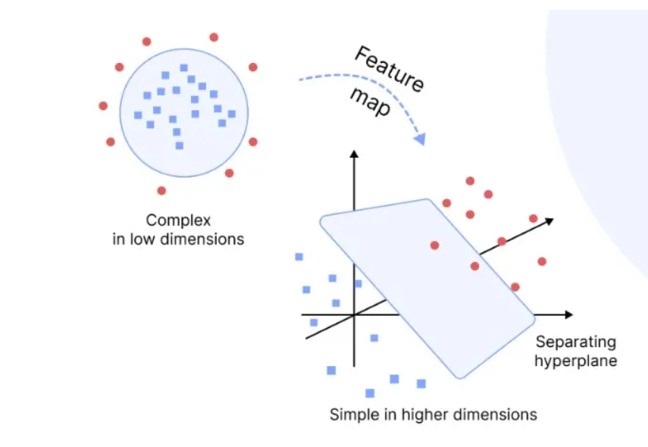
Cont.,
By using kernel functions, data that is not linearly separable in the original space becomes separable in the transformed space, enabling effective classification and regression.

Slide 5
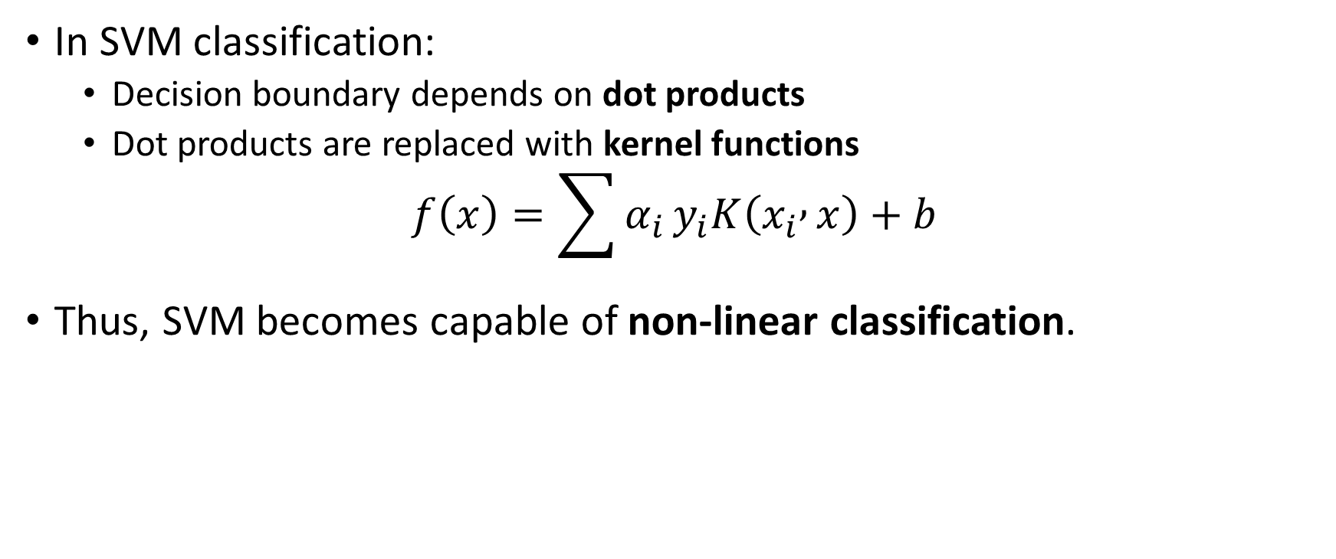
Kernel Methods in SVM
In SVM classification:
Decision boundary depends on dot products
Dot products are replaced with kernel functions
$$f\left(x\right)=\sum{α_{i}}y_{i}K\left(x_{i} , x\right)+b$$
Thus, SVM becomes capable of non-linear classification.

Slide 6
Common Kernel Functions
Linear Kernel-K(x,x′)=x⋅x′
Polynomial Kernel-K(x,x′)=(x⋅x′+c)d
(d = degree of polynomial)
Radial Basis Function (RBF) Kernel -K(x,x′)=exp(−γ∣∣x−x′∣∣2)
γ controls influence of points
Sigmoid Kernel-K(x,x′)=tanh(αx⋅x′+c)
These kernels allow algorithms like Support Vector Machines (SVM) to perform classification and regression tasks in a high-dimensional space efficiently.

Slide 7
Types of Kernel Methods
Kernel SVM
Kernel Ridge Regression
Kernel PCA
Gaussian Process Regression

Slide 8
Limitations of Kernel Methods
High computational cost for large datasets
Kernel and parameter selection is challenging
Less interpretable than linear models

Slide 9
Applications of Kernel Methods
Image classification
Text categorization
Bioinformatics
Speech recognition
Pattern recognition

Slide 10
Instance-Based Methods
Instance-Based Learning stores training examples instead of building an explicit global model.
Also known as lazy learning, they make predictions by finding similar instances in the training data.
Key Characteristics
Store all training data
No explicit training phase
Local approximation
Computationally intensive at prediction time

Slide 11
Cont.,
Predictions are made using local approximations rather than a single global hypothesis.
Each query instance may result in a different approximation of the target function.
Instance-based methods are effective when the target function is complex but locally simple.
Most methods assume instances can be represented as points in a Euclidean space.

Slide 12
Common instance-based techniques include:
Nearest Neighbor
k-Nearest Neighbor
Locally Weighted Regression

Slide 13
K-Nearest Neighbors (KNN)
The most popular instance-based method classifies new data points based on the majority class of their K nearest neighbors.
Store Training Data
Keep all labeled examples in memory
Calculate Distance
Measure similarity to all stored instances
Find K Neighbors
Identify the K closest training examples
Vote & Classify
Assign class based on majority vote

Slide 14
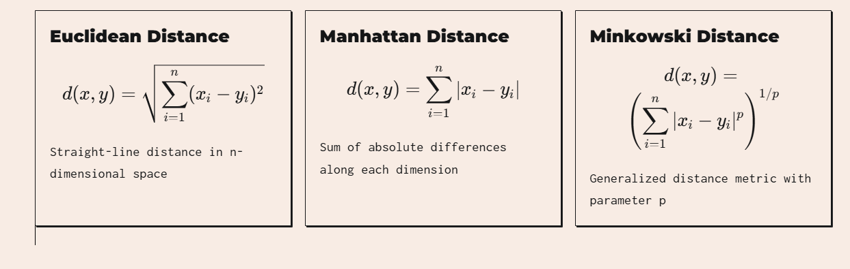
Distance Metrics
Instance-based methods rely on distance functions to measure similarity between data points.

Slide 15
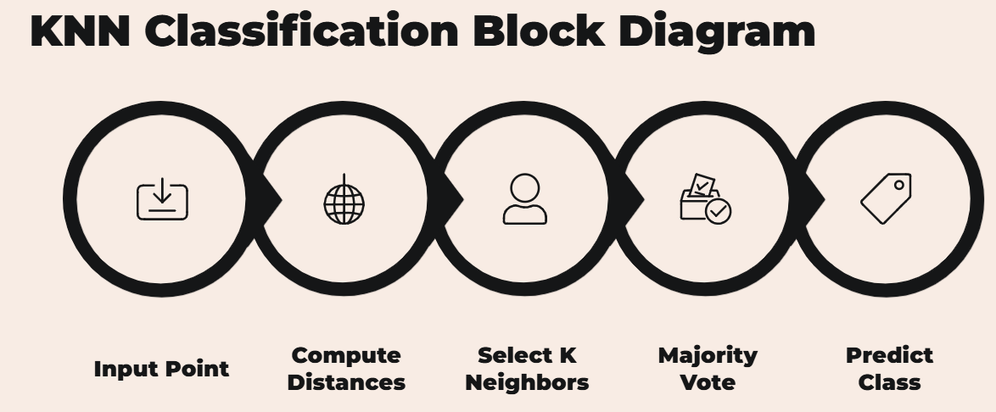

Slide 16
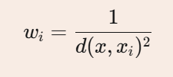
Advanced Variations
Weighted KNN
Assigns higher importance to closer neighbors using distance-based weights
Radius-Based
Considers all neighbors within a fixed radius instead of K nearest
Condensed KNN
Reduces storage by keeping only boundary instances that affect classification

Slide 17
Case-Based Reasoning (CBR).
Some approaches use symbolic representations, known as Case-Based Reasoning (CBR).
Case-based reasoning reuses previously solved cases to solve new problems.
Applications of case-based reasoning include:
Help-desk support systems
Legal reasoning using past cases
Scheduling and planning problems

